Slide 1
Large‑scale ETL / log analytics
Presented for:
Dr Mohamad AOUDE
</> Fatima Moselmani
</> Fatima Jawad

Slide 2
Table of contents
01
02
03
04
05
06
Introduction
Why this project?
Objective
System Architecture
Performance & Results
Conclusion

Slide 3

1. Introduction
What is ETL?
Extract: extract data from log files
Transform: Clean, format, structure the data
Load: Store the processed data
What Are Logs?
Why Analyzing Logs Is Important?
2025-07-10 14:32:01 ERROR Database connection failed
2025-07-10 14:32:03 INFO User zahraa logged in

Slide 4
2. Why this project?
Large volumes of logs are generated continuously
Sequential processing is too slow
Need for an efficient, scalable log analytics pipeline

Slide 5
3. Objectives
Build an ETL pipeline for log processing
Extract useful analytics from logs
Implement both sequential and concurrent versions
Make comparison
Store and possibly visualize results

Slide 6

04
System Architecture

Slide 7
4.1 System Components
GUI Output:
Tabbed interface with thread count options (4, 8, 12, 16)
Log Input:
NASA-style .log text file
Role-specific Analysis:
Admin, Developer, Analyst views
Sequential Analyzer:
Line-by-line parser and aggregator
Parallel Analyzer: ThreadPool-based chunk processing

Slide 8
4.2 Tools and Technologies Used
Concurrency Model
GUI Framework
Programming Language
Java
ExecutorService(Thread Pools)
Java Swing
Log Data
Testing
Performance Measurement
NASA HTTP access logs
Unit tests for parsing
GUI content checks
Instant.now()
speedup formulas
CSV logging

Slide 9
Sequential
Parallel
Simple line-by-line parsing
Divide file into chunks
→
parse/process in parallel
→
merge results.

Slide 10
4.3 Sequential Approach
Line-by-line parsing on a single thread
Each line parsed into structured LogEntry object
Results aggregated in one pass
Simple but slower for large log files

Slide 11
4.4 Parallel Approach
Reads all log lines into memory
Divides lines into N equal chunks (one per thread)
Each thread parses its chunk independently
Merge results after all tasks complete
Thread pool (ExecutorService) ensures efficient CPU usage

Slide 12
4.5 Parallel Techniques Used
ExecutorService (thread pool) for concurrency
Callable tasks returning future results
SwingWorker for responsive GUI during processing
Independent work avoids synchronization overhead

Slide 13
Examples
Demo

Slide 14
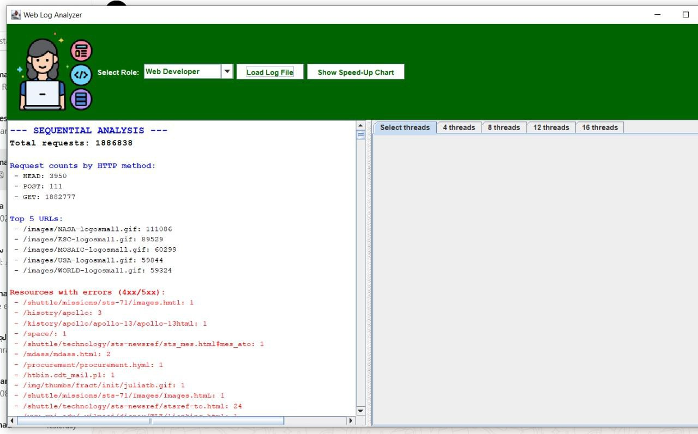

Slide 15
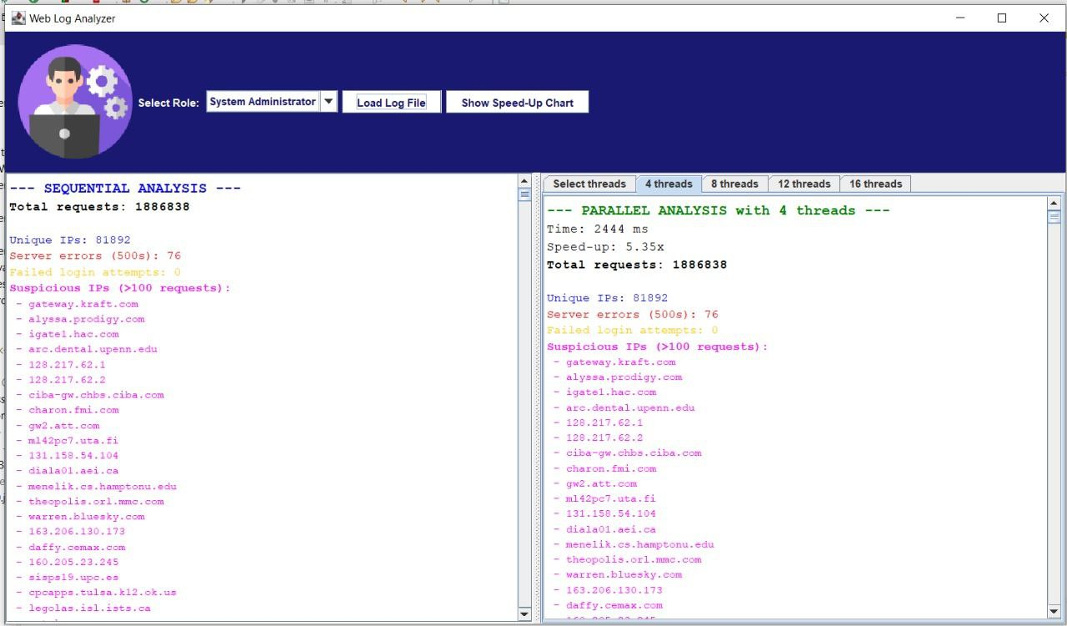

Slide 16
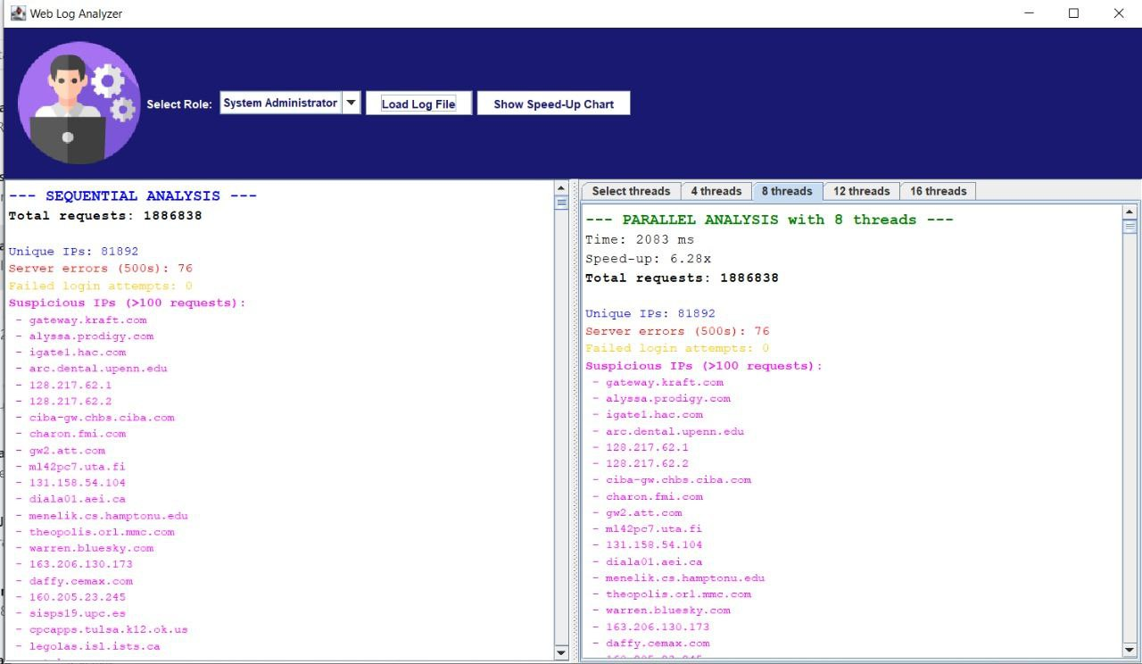

Slide 17
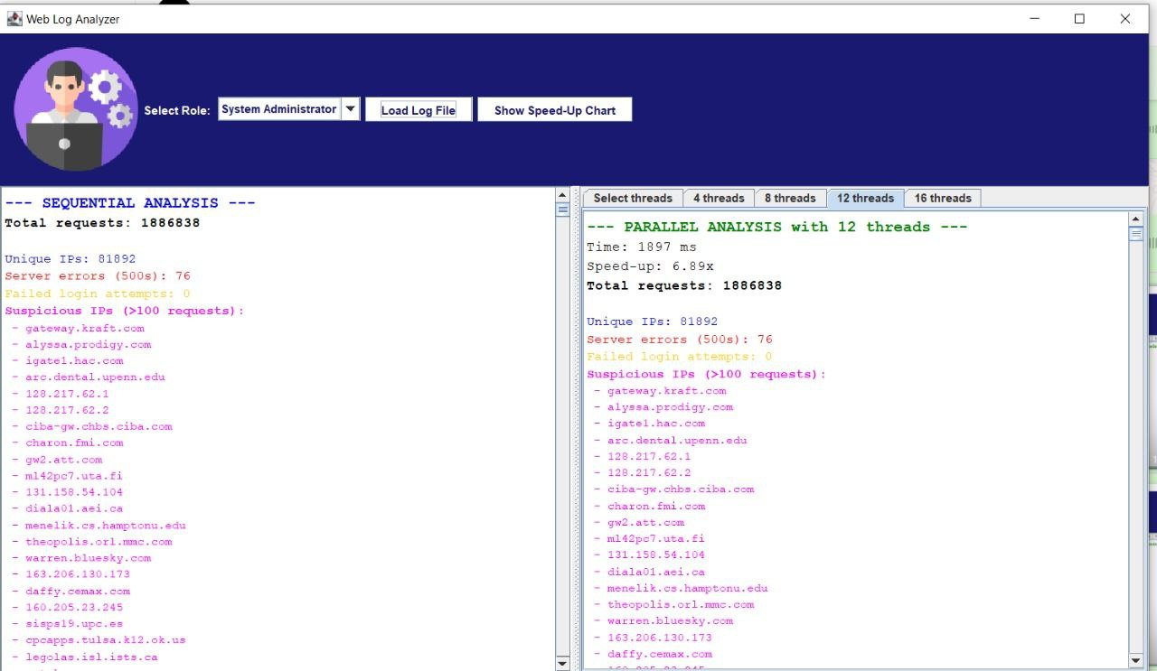

Slide 18
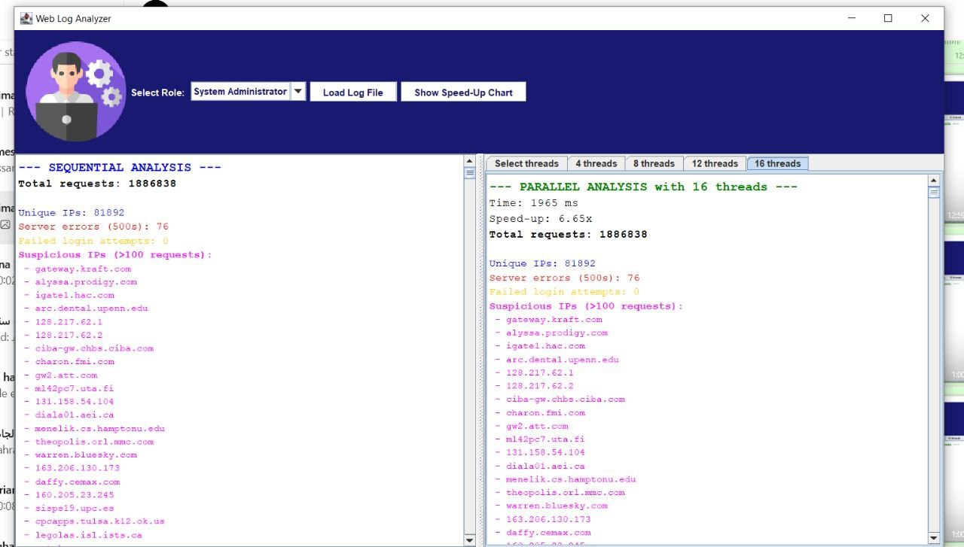

Slide 19
5. Performance
4 threads
X 2.6768
8 threads
X 3.6919
12 threads
X 3.7638
16 threads
X 4.0631

Slide 20
Output Visualization
Role-specific analysis displayed in text
Dynamic charts implemented using JFreeChartVisualize requests per IP, HTTP methods, suspicious activity
Speed-up and efficiency charts for parallel performance

Slide 21
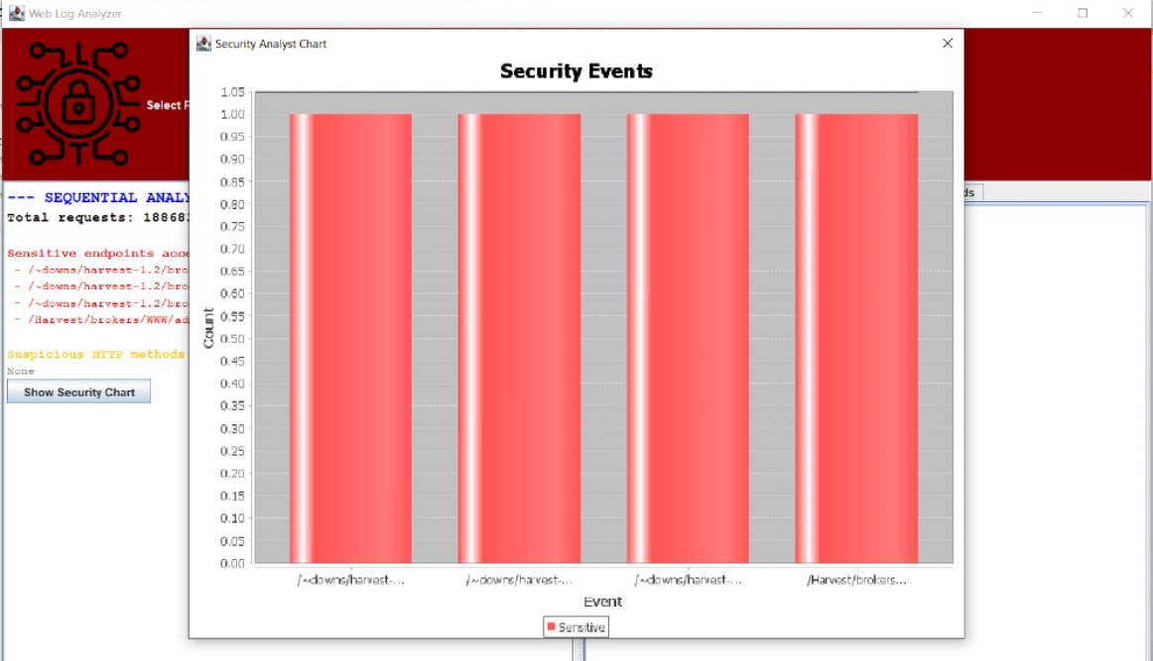

Slide 22
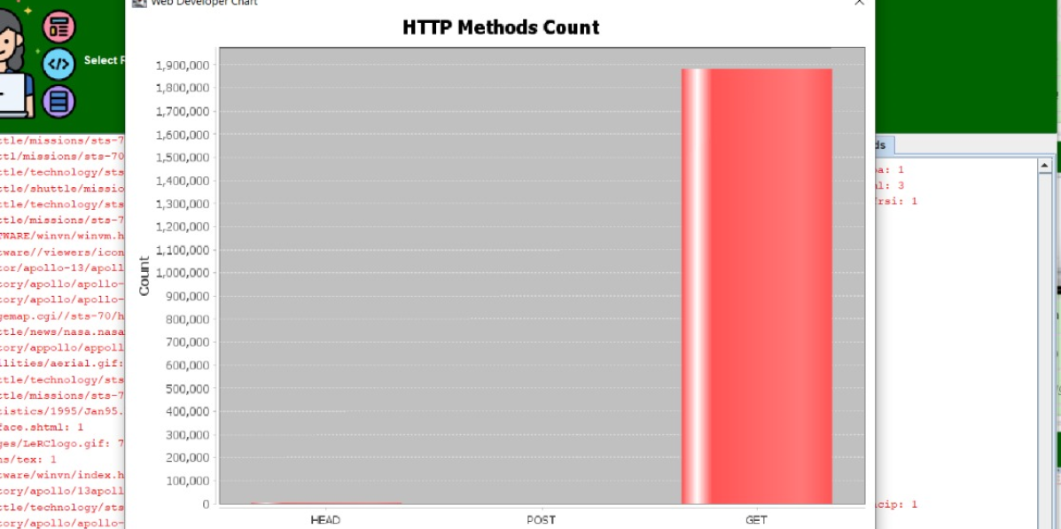

Slide 23
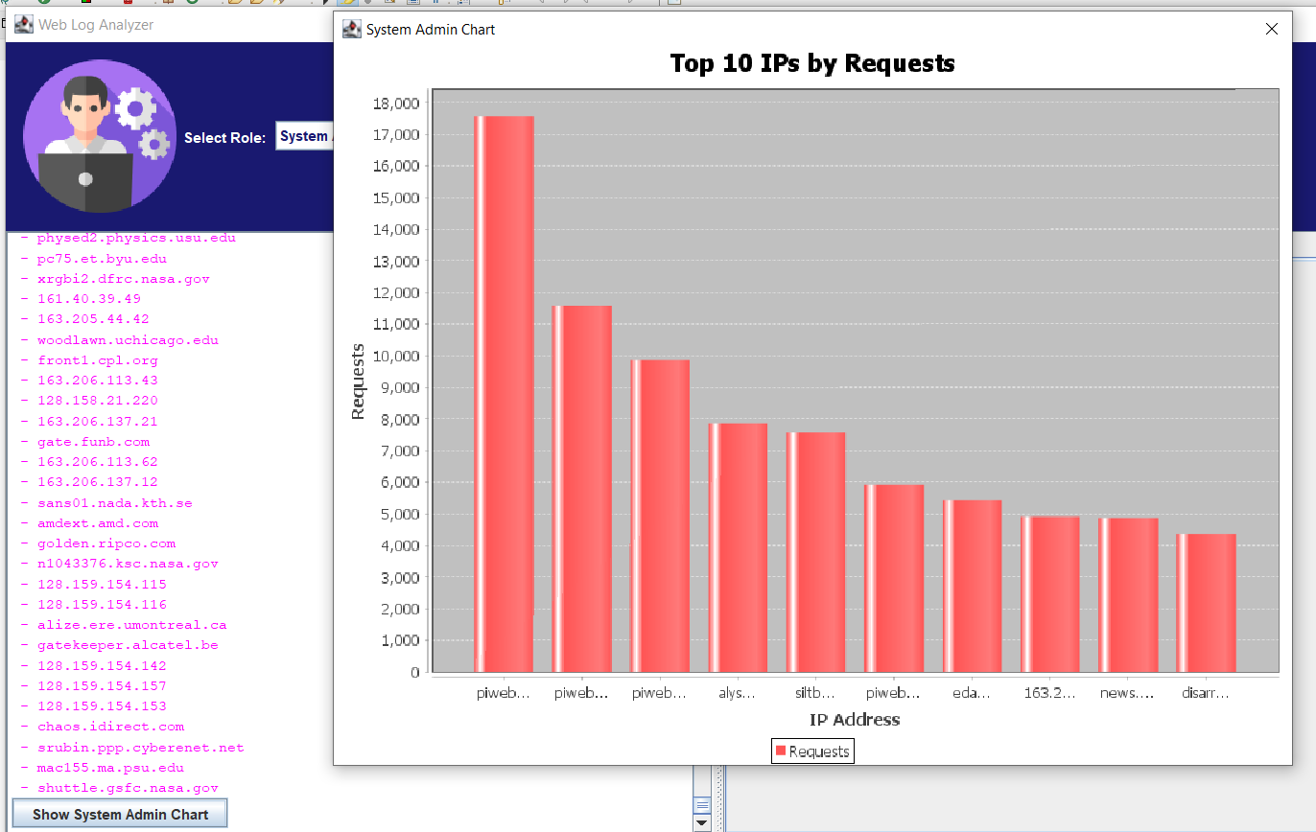

Slide 24
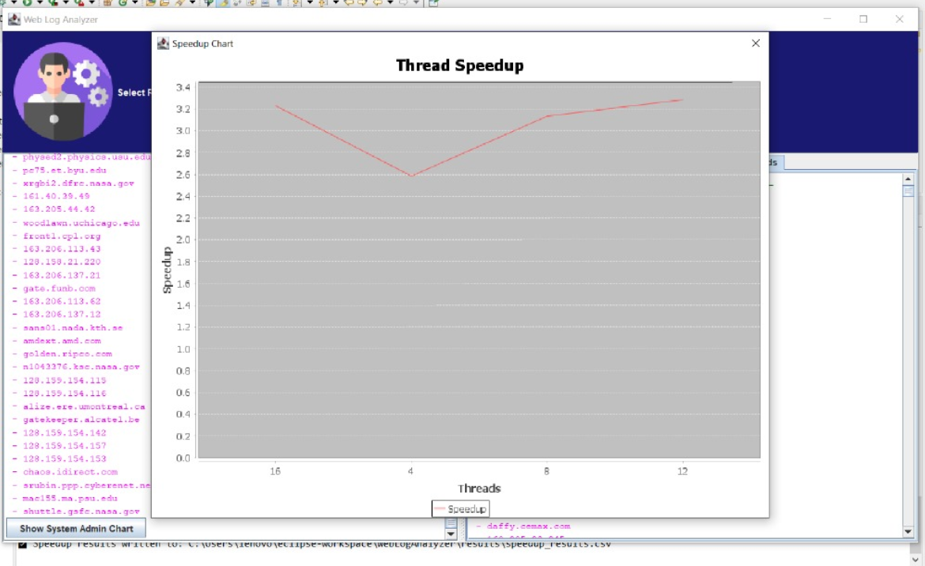

Slide 25

6. Conclusion
1001010100101010
1010010010110111

Slide 26
Thanks!
Any questions?

